Slide 1
Publishing Reports via Bookdown/GitHub Pages
S Perry
CA Department of Water resources

Slide 2
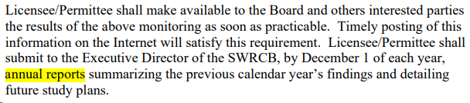

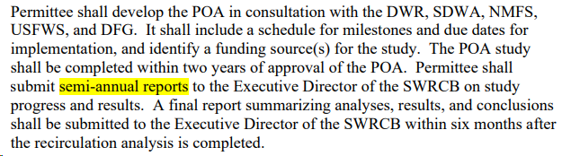
Goal: Meet Reporting Requirements
Want a simple, reproducible way to generate and publish reports
Notes:
Many of our programs include mandates to update management ….; EMP, for example, is required by D-1641 to write annual reports for each component of our program
Some programs, like EMP, have specific requirements to make all annual reports publicly accessible

Slide 3

Method: Bookdown
R package that facilitates writing and publishing reports with R Markdown
Can create a website to host your reports
Can save reports as PDFs, Word Docs, etc.
Can add figures, tables, Shiny apps, math equations, etc.
Can customize the format, layout, and design
Notes:
More general overview

Slide 4
Method: Bookdown
R package that facilitates writing and publishing reports with R Markdown
Can create a website to host your reports
Can save reports as PDFs, Word Docs, etc.
Can add figures, tables, Shiny apps, math equations, etc.
Can customize the format, layout, and design
Notes:
In particular, to meet public reporting requirements, it’s useful to take advantage of the ability to publish to GitHub’s servers

Slide 5
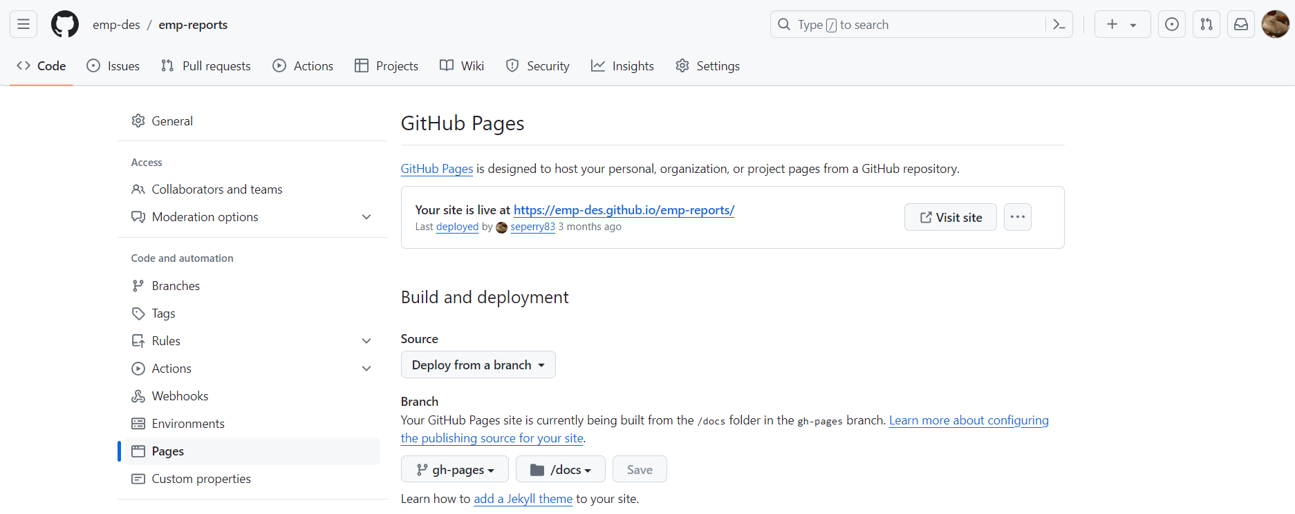
Publishing: GitHub Pages
GitHub Pages turns your repository into a website
free hosting and easy to use
ability to choose custom domain name

Slide 6
Example: EMP Phytoplankton Report
https://emp-dwr.github.io/emp-website/
Notes:
In this presentation, will go through an example of a published report and the basics of how to create one

Slide 7
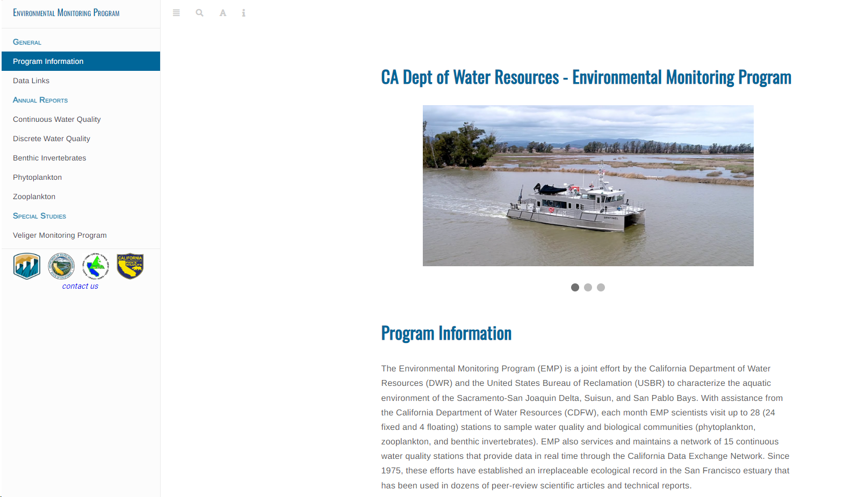

Slide 9
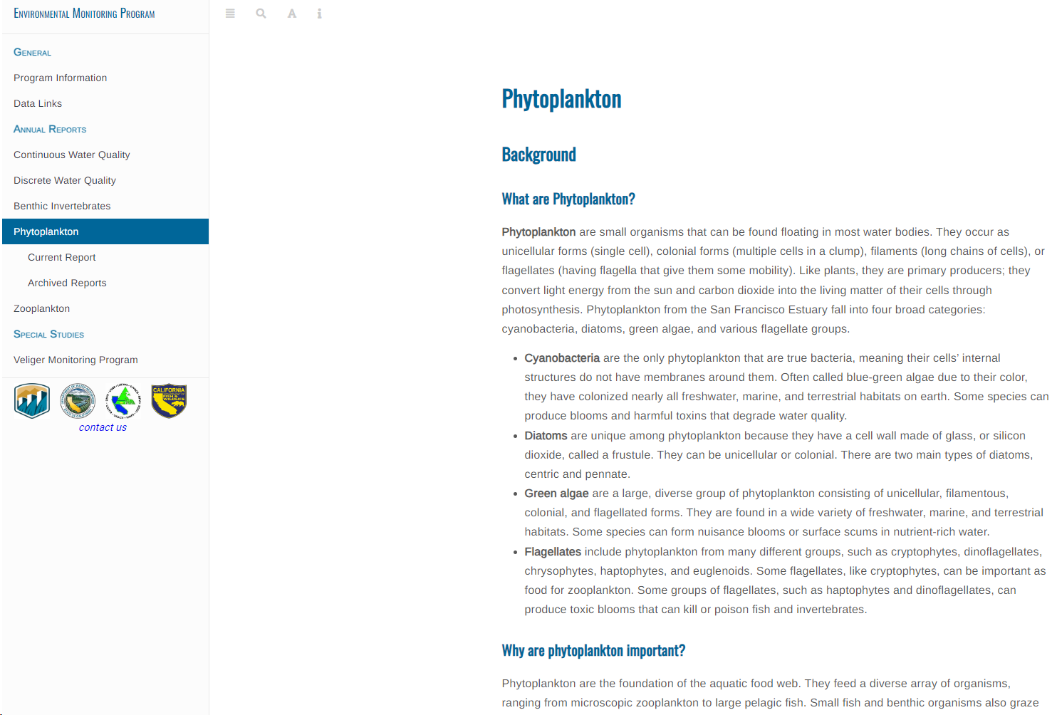

Slide 10
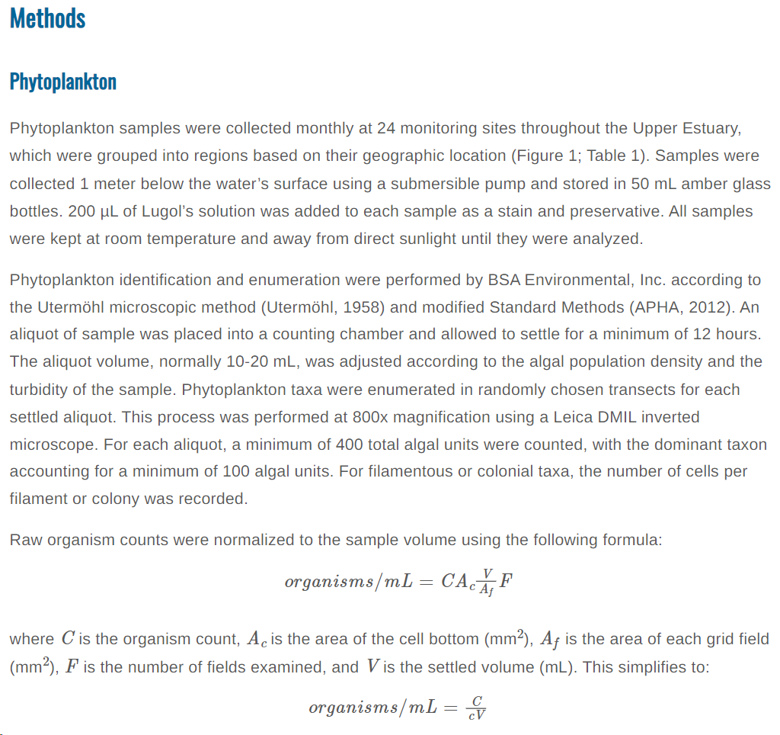
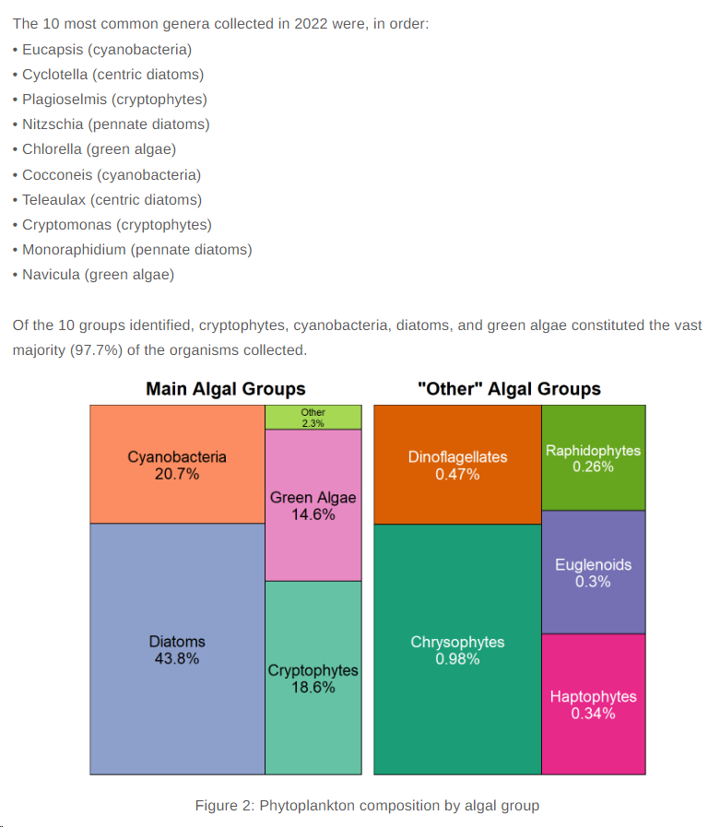

Slide 11
How to Publish via Bookdown/GitHub Pages

Slide 12
General Workflow
Create a GitHub Repository
Create YAML file
Specify additional YAML in .Rmd file
different ways to do this
Create reports in R Markdown files
Run R file to render reports (and publish to GitHub Pages)
Check that deployment was successful

Slide 13
General Workflow
Create a GitHub Repository
Create YAML file
Specify additional YAML in .Rmd file
different ways to do this
Create reports in R Markdown files
Run R file to render reports (and publish to GitHub Pages)
Check that deployment was successful

Slide 14
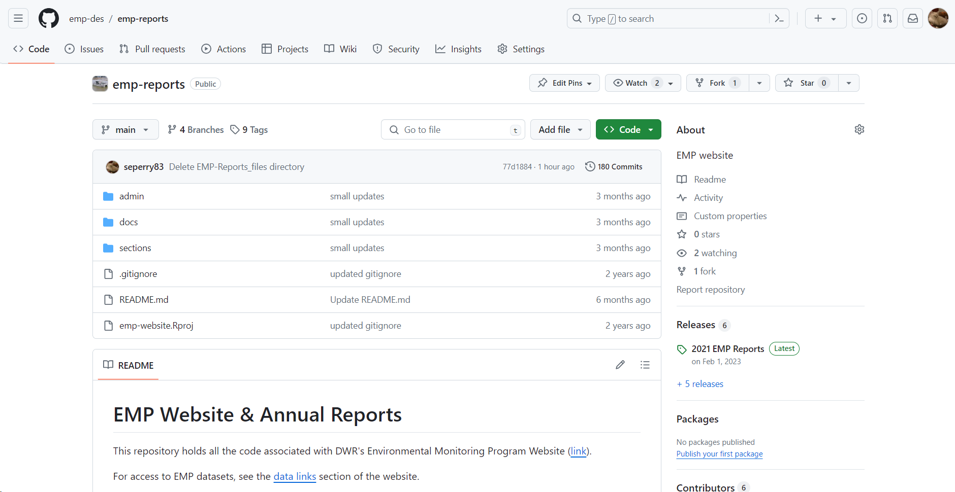
Notes:
this repository hosts all files relevant to the report/website; repository name is also the URL
the specific filepaths and such are up to user discretion, but there are a few key components:

Slide 15
Notes:
the specific filepaths and such are up to user discretion, but there are a few key components:

Slide 16
General Workflow
Create a GitHub Repository
Create YAML file
Specify additional YAML in .Rmd file
different ways to do this
Create reports in R Markdown files
Run R file to render reports (and publish to GitHub Pages)
Check that deployment was successful

Slide 17
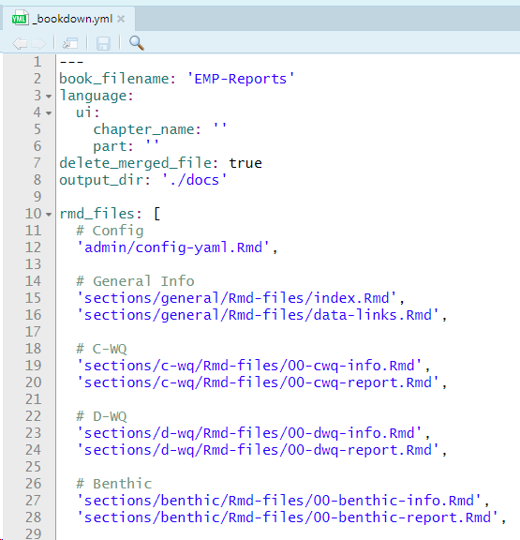
metadata
markdown files
containing the reports
Notes:
yml: markup language for configuration files. What this simply means is it tells Bookdown the basics of how to build your website

Slide 18
General Workflow
Create a GitHub Repository
Create YAML file
Specify additional YAML in .Rmd file
different ways to do this
Create reports in R Markdown files
Run R file to render reports (and publish to GitHub Pages)
Check that deployment was successful

Slide 19
metadata
markdown files
containing the reports
Notes:
yml: markup language for configuration files. What this simply means is it tells Bookdown the basics of how to build your website

Slide 20
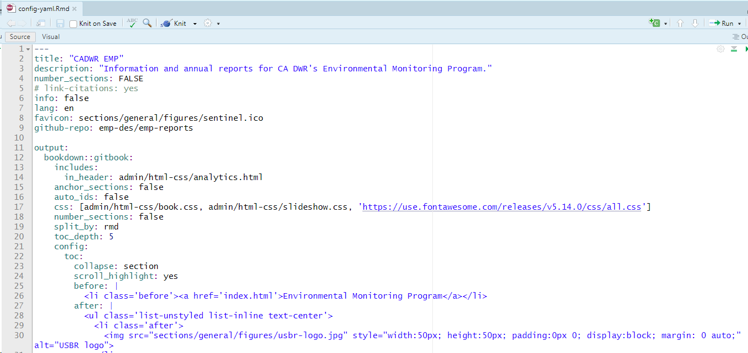

Slide 21
Google Analytics

Slide 22
layout/design

Slide 23
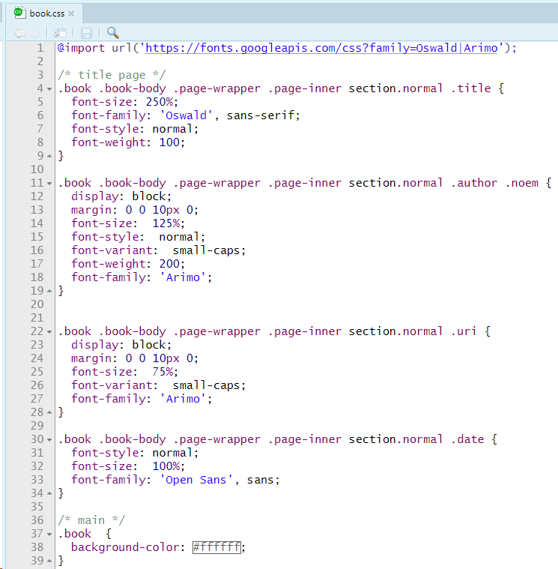
Feel free to use as a template:
https://github.com/emp-des/emp-reports/blob/main/admin/html-css/book.css

Slide 24
General Workflow
Create a GitHub Repository
Create YAML file
Specify additional YAML in .Rmd file
different ways to do this
Create reports in R Markdown files
Run R file to render reports (and publish to GitHub Pages)
Check that deployment was successful

Slide 25
metadata
markdown files
containing the reports
Notes:
yml: markup language for configuration files. What this simply means is it tells Bookdown the basics of how to build your website

Slide 26
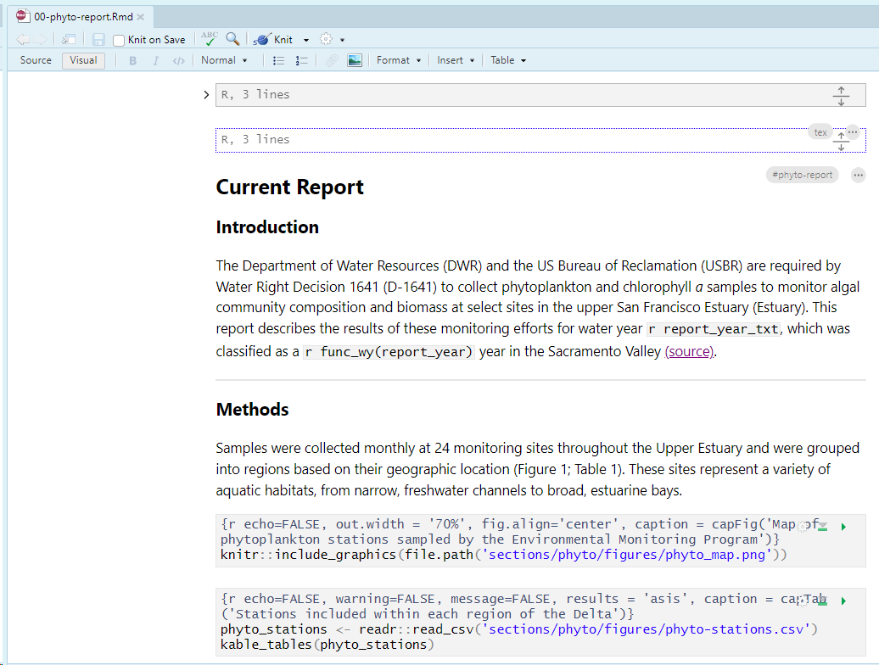

Slide 27
write text normally

Slide 28
inline R functions

Slide 29
add figures and
tables

Slide 30
General Layout
Create a GitHub Repository
Create YAML file
Specify additional YAML in .Rmd file
different ways to do this
Create reports in R Markdown files
Run R file to render reports (and publish to GitHub Pages)
Check that deployment was successful

Slide 31
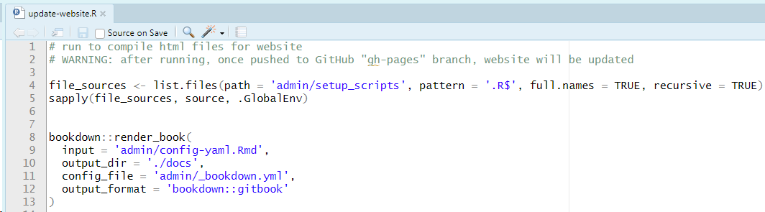

Slide 33
Notes:
the specific filepaths and such are up to user discretion, but there are a few key components:

Slide 35
General Workflow
Create a GitHub Repository
Create YAML file
Specify additional YAML in .Rmd file
different ways to do this
Create reports in R Markdown files
Run R file to render reports (and publish to GitHub Pages)
Check that deployment was successful

Slide 36
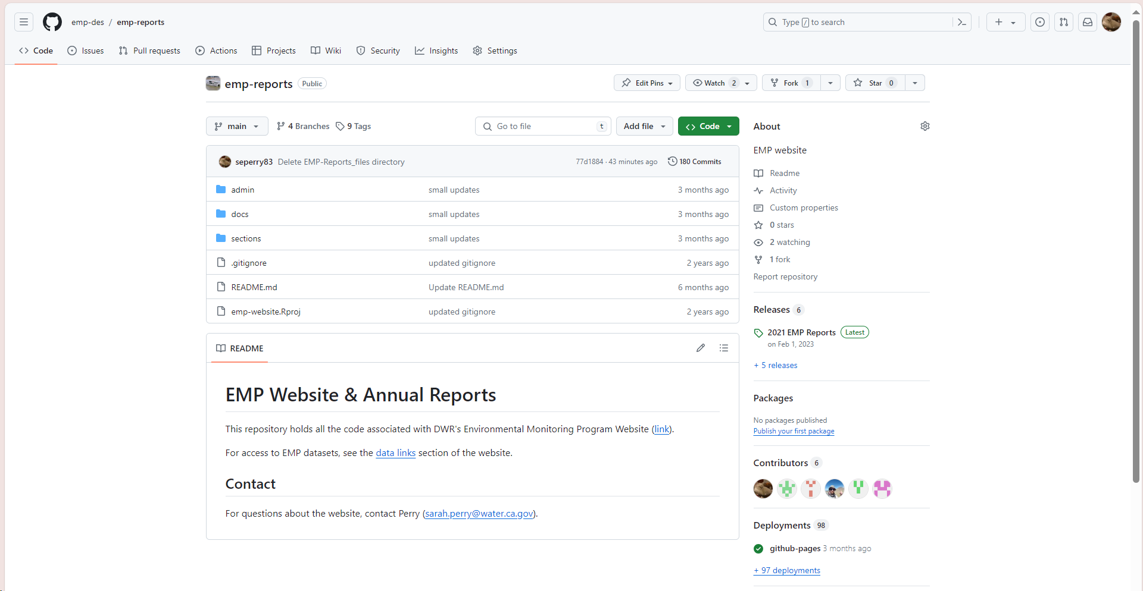

Slide 37
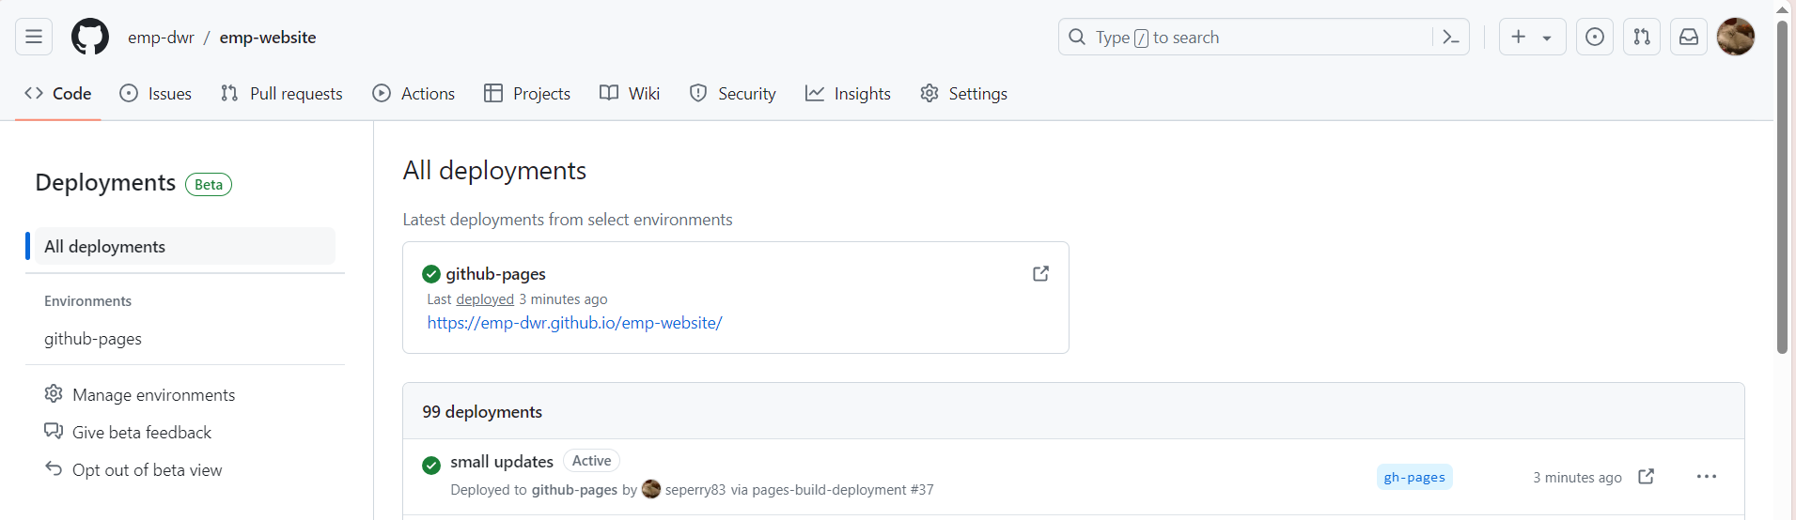
deployment successful ☺

Slide 38



Thank You!
Additional Resources:
Bookdown Reference:
https://bookdown.org/
CSS Template:
https://github.com/emp-dwr/emp-website/blob/main/admin/html-css/book.css
Contact:
sarah.perry@water.ca.gov

